Slide 1
Nuclear Fuel Performance
NE-533
Spring 2025

Slide 2
Notes
Wellness day on Tuesday 2/11
No class
do something fun, take some time off, take care of yourself
For events, activities, support:
https://wellness.ncsu.edu/wellness-day/
Less fun news… paper project will be assigned next week
Let me know if you prefer a specific topic area
Reminder to make progress on your MOOSE project
Exam on module 2 planned for Feb. 20

Slide 3
Last Time
We developed analytical solutions for the stress in a pressurized cylinder with a thick wall
Increases in temperature cause most materials to expand, which is a strain that doesn’t inherently cause stress
Thermal expansion can cause stress when
Deformation is constrained, there are gradients in the expansion coefficient, there is a temperature gradient
We developed analytical equations for thermal stresses
in the cladding and in the fuel

Slide 4
NUMERICAL THERMO-Mechanics

Slide 5
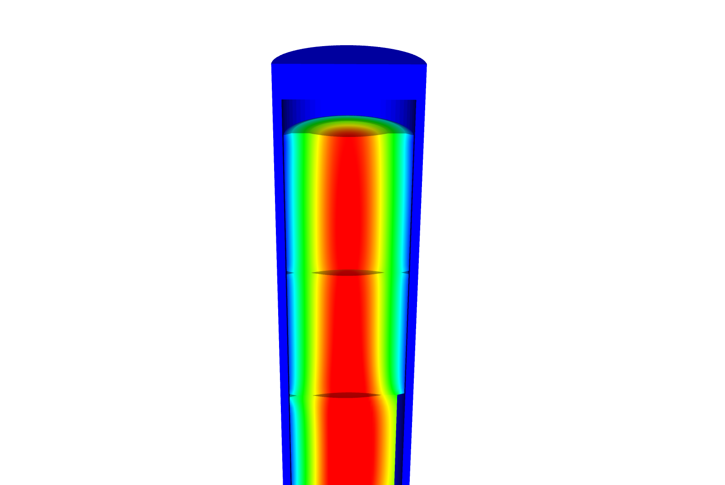
Now we can solve the temperature and the displacement vector for the full thermomechanical problem
T impacts the value of u through thermal expansion
u impacts the value of T through changes in the thickness of the gap
The value for T evolves with time
The value for u also evolves with time, even though there is not time in its PDE

Slide 6
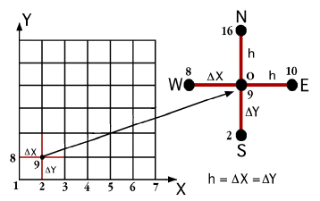
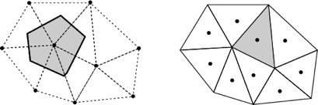
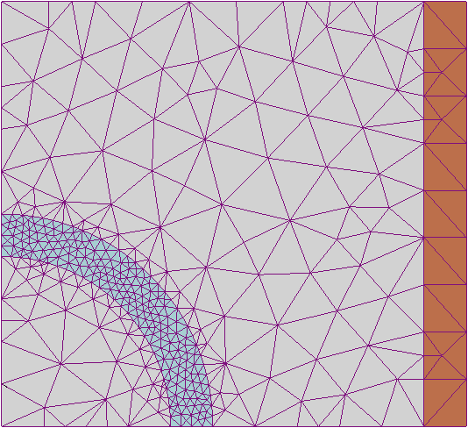
The primary tool for solving all thermomechanics problems is the finite element method
Finite difference
Can solve the heat conduction equation
Can’t easily solve the mechanics equations
Finite Volume
Can solve the heat conduction equation
Can solve the mechanics equations
Eqns derived from fluid dynamics
Finite Element
Can solve the heat conduction equation
Can solve the mechanics equations
Can handle any geometry
Can handle any boundary condition

Slide 7
The 1D thermomechanics problem definition
dT/dr = 0
u_{r} = 0
R_{f}
T_{r} = T_{s}
du_{r}/dr = 0
r
The initial temperature is set to 273 K
We will take 50 time steps of 0.5 s
The full power of Q = 450 begins at time t = 0.
UO₂ material properties are used for both the thermal and mechanics equations

Slide 8
Comparison to analytical theory
If we use a constant thermal conductivity, analytical 1D model matches very well
When k is a function of temperature, there is a difference between the FEM and analytical stress

Slide 9
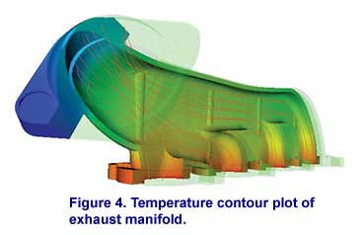
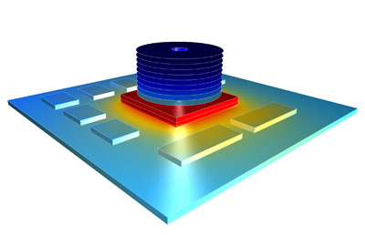

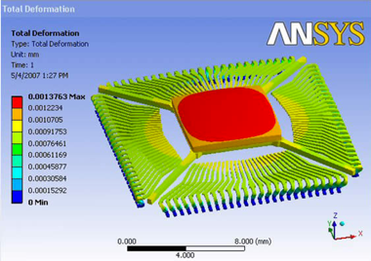

There are various available tools for solving coupled thermomechanical problems with FEM
Commercial tools
ABAQUS
ANSYS
COMSOL
Open source
MOOSE
NRC-based
FRAPCON/FRAPTRAN

Slide 10
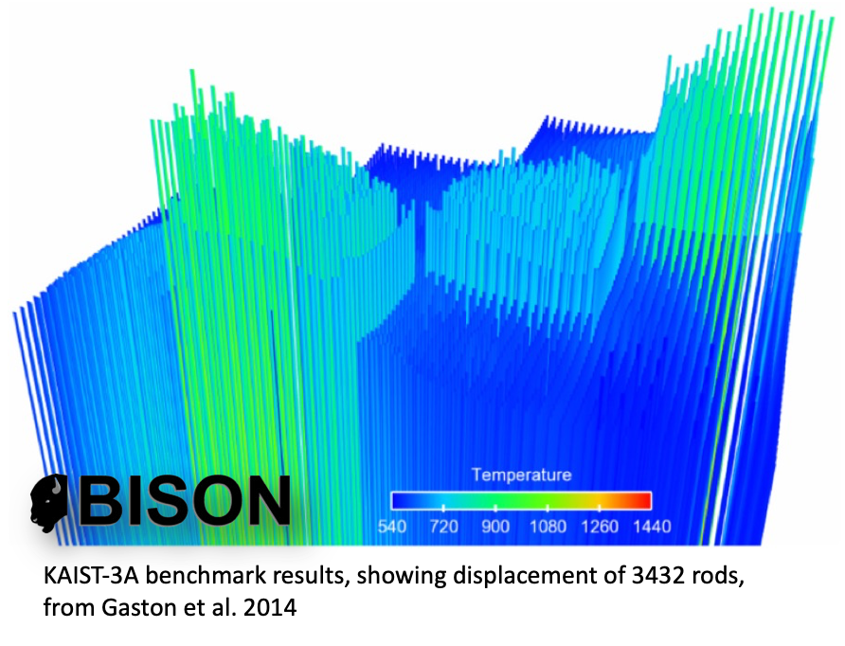
The purpose of a fuel performance code is to simulate and evaluate fuel rod behavior
The first fuel performance codes were developed in the mid seventies
Advanced fuel performance codes are still under development today

Slide 11
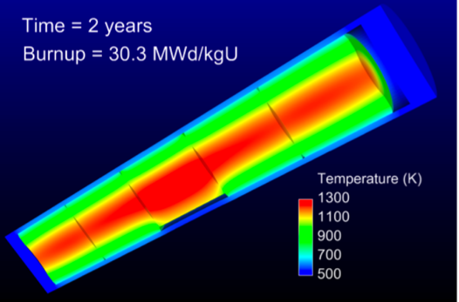
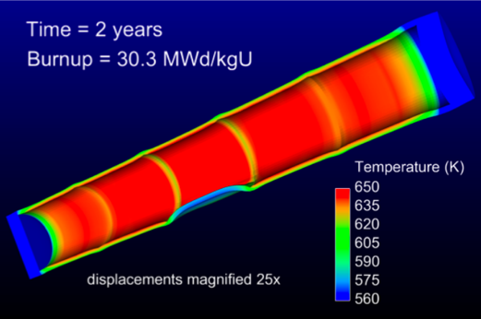
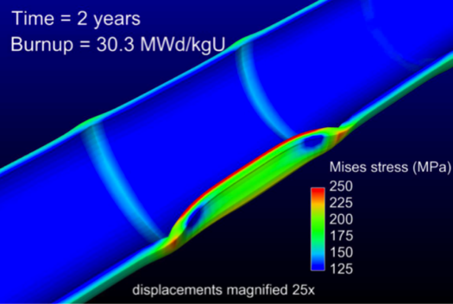
How are fuel performance codes used?
The primary goals are to predict the fuel centerline temperature and the stress in the cladding
Fuel performance codes aren’t focused on predicting power production, but rather to predict safety margins, provide coupling to other codes

Slide 12
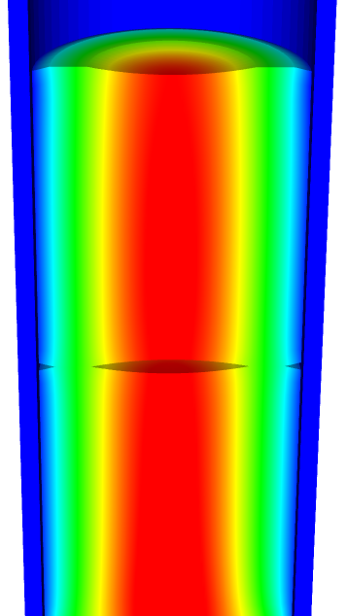
A fuel performance code must be able to predict:
Fuel
Temperature profile
Volumetric change
Gap
Gap heat transport
Mechanical interaction between fuel and cladding
Gap pressure
Cladding
Temperature profile
Stress

Slide 13
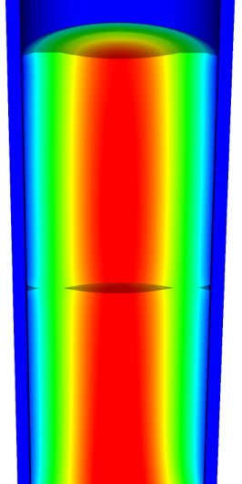
The primary focus is solving the thermomechanical problem
Fuel
Solved Numerically
Gap
The handling of the gap changes the most between different codes
Solved Numerically or analytically
Cladding
Solved Numerically or analytically
Solved Numerically

Slide 14

Various approaches to model the fuel rod
Transient, full 3D
Transient, 2D axisymmetric with discrete pellets
Computational cost
Accuracy
Transient, 2D axisymmetric with smeared pellets
Transient, multiple 1D slices (1.5D)
Steady, multiple 1D slices (1.5 D)
Transient, 1D
Steady state, 1D (analytical)

Slide 15
Early fuel performance codes were made for either steady state or transient operation
Steady state codes
Leave off the time derivative part of the heat equation
The material properties still evolve with time as a function of burnup
The volumetric changes in the fuel are also a function of burnup
Creep of fuel and cladding change with time
Transient codes
Include the time derivative
Have similar burnup dependent models like steady state codes, but don’t include creep
Have additional models for rapid transients

Slide 16
Start with FRAPCON
Transient, full 3D
Transient, 2D axisymmetric with discrete pellets
Computational cost
Accuracy
Transient, 2D axisymmetric with smeared pellets
Transient, multiple 1D slices (1.5D)
Steady, multiple 1D slices (1.5 D)
Transient, 1D
Steady state, 1D (analytical)

Slide 17
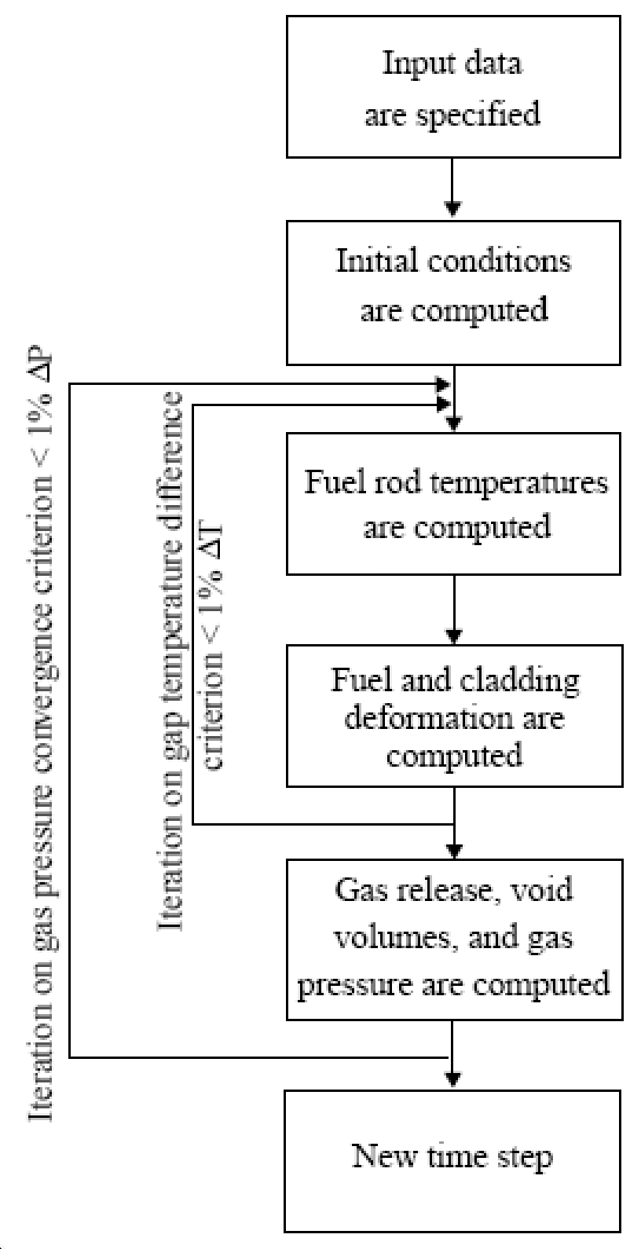
FRAPCON Flow Chart
FRAPCON is the NRC’s steady-state fuel performance code
FRAPCON has the ability to accurately calculate the high-burnup response of light-water reactor fuel rods
FRAPCON iterates to determine fuel rod temperatures, fuel and cladding deformation
This converged data is iterated to produce gas release, void volumes and plenum pressure
Then marches forward in time

Slide 18
FRAPTRAN
Transient, full 3D
Transient, 2D axisymmetric with discrete pellets
Computational cost
Accuracy
Transient, 2D axisymmetric with smeared pellets
Transient, multiple 1D slices (1.5D)
Steady, multiple 1D slices (1.5 D)
Transient, 1D
Steady state, 1D (analytical)

Slide 19
FALCON
Transient, full 3D
Transient, 2D axisymmetric with discrete pellets
Computational cost
Accuracy
Transient, 2D axisymmetric with smeared pellets
Transient, multiple 1D slices (1.5D)
Steady, multiple 1D slices (1.5 D)
Transient, 1D
Steady state, 1D (analytical)

Slide 20
FALCON
FALCON is a 2D fuel performance code developed by EPRI
Development of FALCON started in 1996
The beta version was released in 2003
It was developed by ANATECH for EPRI
FALCON is proprietary, owned by EPRI
It is no longer under active development in the US

Slide 21
FALCON is a 2D transient and steady state code
Fuel
Solved with FEM
Gap
Pressure is calculated using equation of state
Simplified contact model is used for gap closure
Gap heat transfer model is used
Solved with FEM
Cladding
Solved with FEM
Solved with FEM

Slide 22
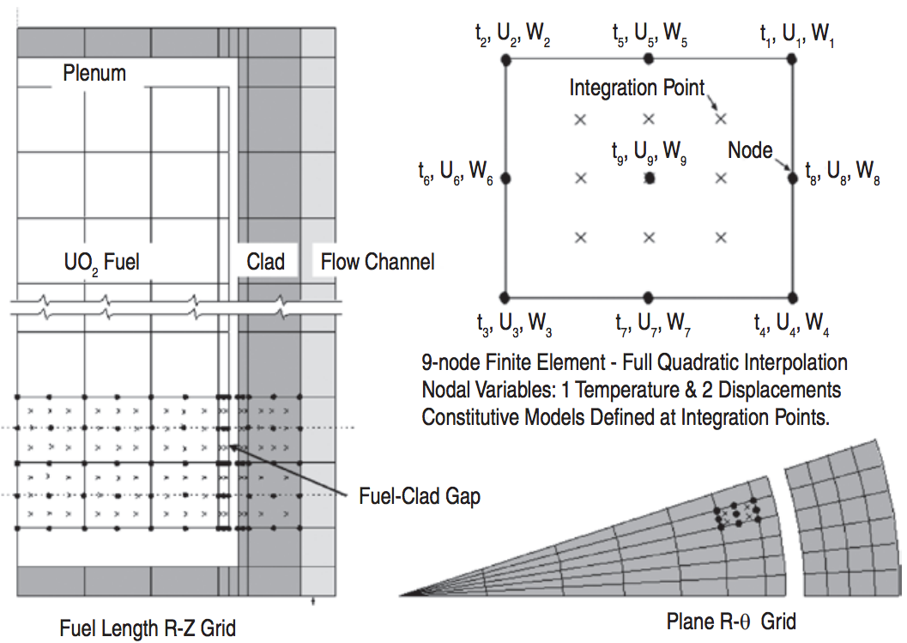
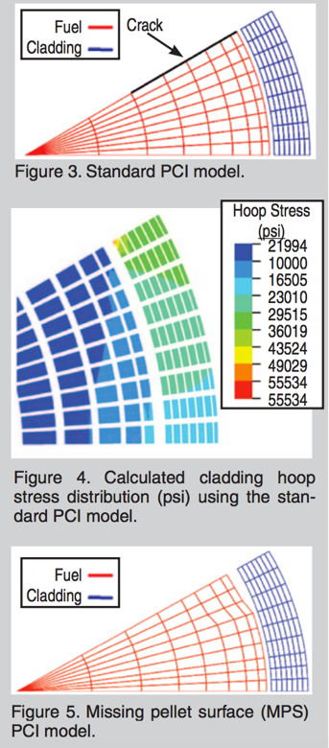
FALCON can predict the fuel performance in axisymmetric RZ space or in Rθ space

Slide 23
BISON
Transient, full 3D
Transient, 2D axisymmetric with discrete pellets
Computational cost
Accuracy
Transient, 2D axisymmetric with smeared pellets
Transient, multiple 1D slices (1.5D)
Steady, multiple 1D slices (1.5 D)
Transient, 1D
Steady state, 1D (analytical)

Slide 24
BISON
The next generation fuel performance code under development in the US
It uses the MOOSE framework
Development was begun in 2008
The first paper using BISON was published in 2009 and the paper summarizing its full capabilities was published in 2012
It was developed at Idaho National Laboratory, with some support by ANATECH
BISON is available for free, but it is export controlled and requires a license agreement be signed

Slide 25
BISON models the fuel behavior ranging from 1D to full 3D and uses FEM
Fuel
Solved with FEM
Gap
Pressure is calculated using equation of state
Fully implemented implicit contact algorithm
Gap heat transfer model is used
Solved with FEM
Cladding
Solved with FEM
Solved with FEM

Slide 26
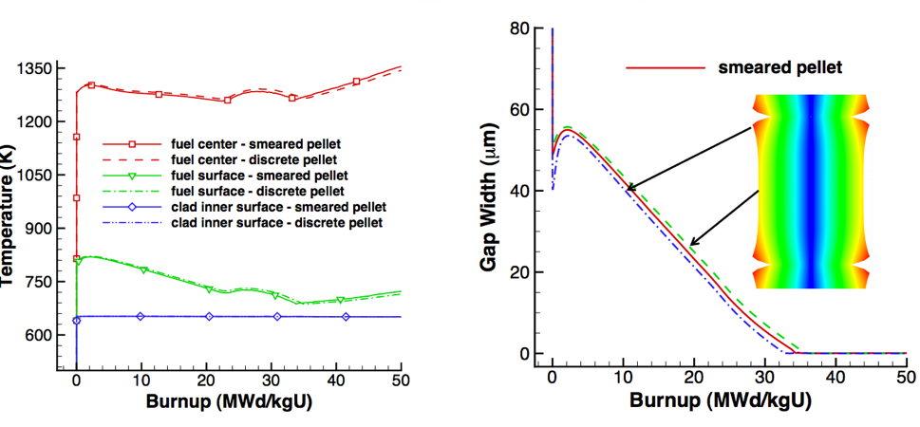
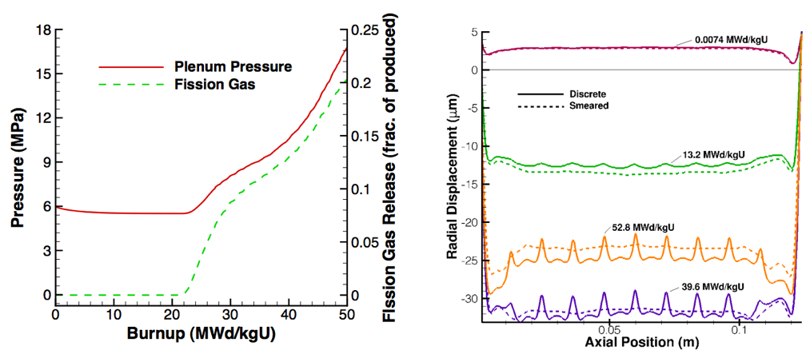
Can handle smeared or discrete pellets, asymmetric pellet geometry and deformation

Slide 27
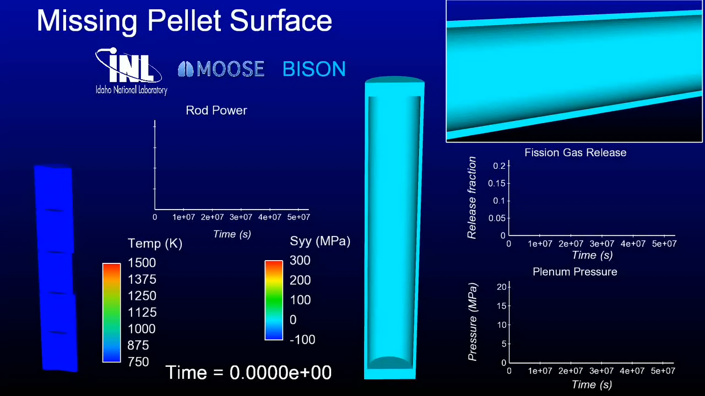
Because of its unique 3D capability, BISON can model truly 3D fuel performance problems

Slide 28
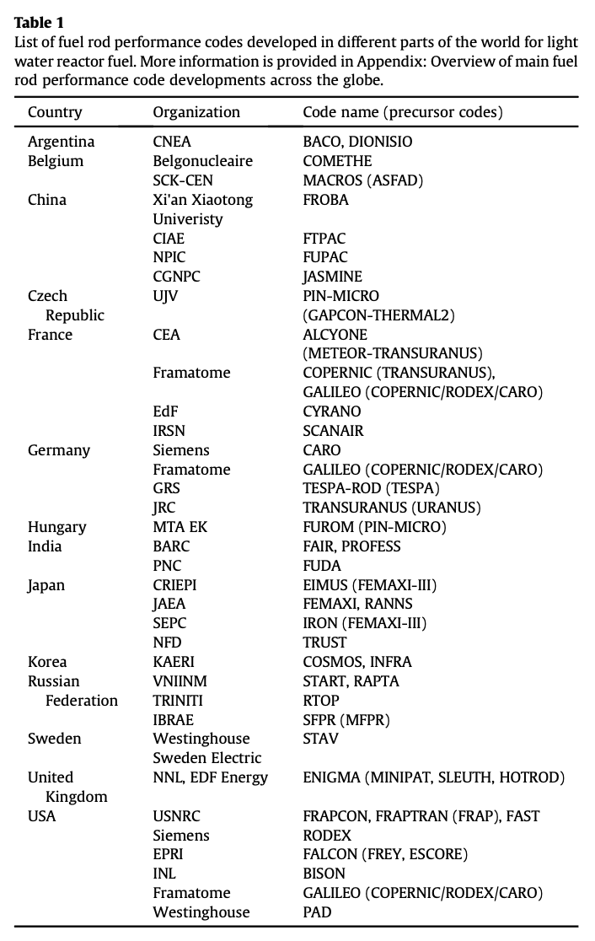
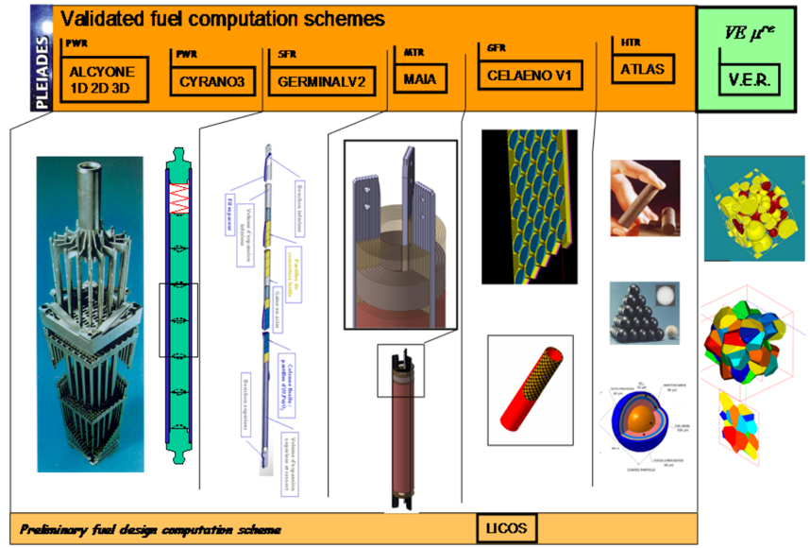
Other countries have other fuel performance codes
http://www.materials.cea.fr/en/PDF/PLEIADES-Platform.pdf

Slide 29
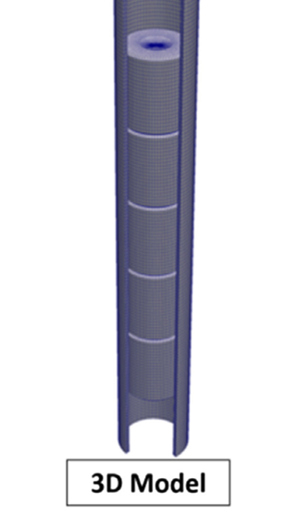
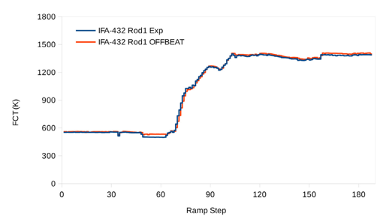
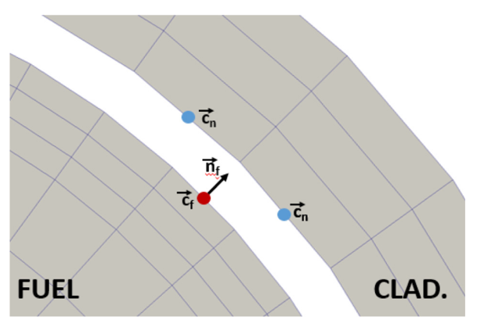
OFFBEAT – new(ish) tool
The OpenFOAM Fuel BEhavior Analysis Tool (OFFBEAT) is a multi-dimensional fuel performance code developed in Switzerland
The code can be used both for studying complex 2D or 3D local effects and for more traditional 1.5D base irradiation analyses
OFFBEAT is based on the open-source C++ library OpenFOAM, thus the governing equations are discretized with modern finite volume techniques

Slide 30
Summary
Fuel performance codes are focused on predicting the center temperature of the pellet and the stress in the cladding
All fuel performance codes
Numerically model the temperature in the fuel
Numerically model the stress in the cladding
Consider gap pressure, closure, and heat transfer
The primary US codes are
FRAPCON – Steady state 1.5D, uses finite difference
FRAPTRAN – Transient 1.5D, uses finite difference
BISON – Steady or transient, 1D – 3D, uses finite element

Slide 31
Material Property Evolution

Slide 32
Pretty much everything we have learned so far, nothing changes once the fuel and cladding reach steady state

Slide 33
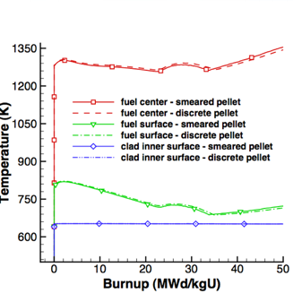
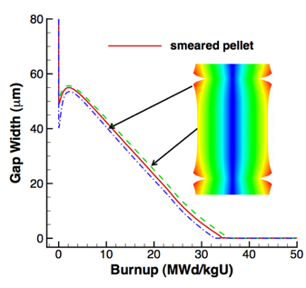
Fuel is dynamic!

Slide 34
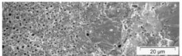
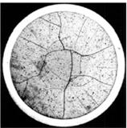
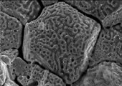


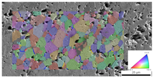
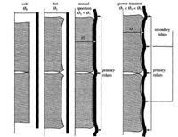
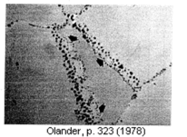
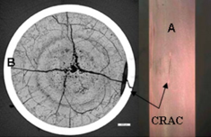

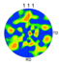
Property changes due to microstructure evolution during reactor operation must be considered
Insertion in reactor
Removal from reactor
Early life
Thermal expansion
Fracture
Point defect and fission gas generation
Fuel Densification
Mid Life
Point defect diffusion
Point defect clustering
Fission gas segregation to GB and voids
Bubble nucleation
Late life
Fission product swelling
Bubble percolation and fission gas release
Cladding creep
Fuel creep
Fuel failure
Pellet/cladding interaction
Cladding corrosion
Cladding fracture
Fuel Fabrication
Sintered UO²
Height 2 cm
Diameter 1 cm
~10 μm grain size
Density > 95%
Brohan 2000
From Pedro Peralta, ASU
Zinkle and Singh 2000
Santana et al. 2011

Slide 35
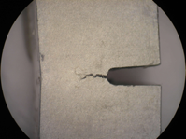
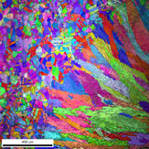
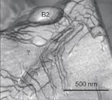
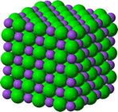
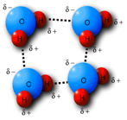
The properties and performance of a material are a result of factors across various length scales
Material properties and performance
Microstructure
Defect interactions
Crystal structure
Chemical bonds

Slide 36
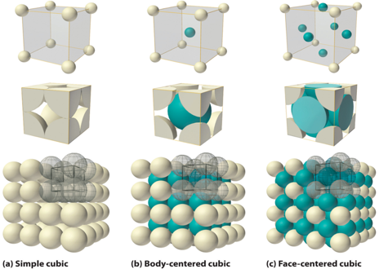
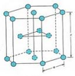
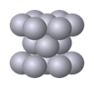
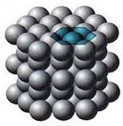
The crystal structure of a material is the shape of the ordered structure of the atoms
The atoms of many materials form an organized lattice, these are called crystalline materials. All reactor materials are crystalline.
The configuration of the atoms in the lattice impacts the properties of the material (density, thermal expansion coefficient, elastic modulus, etc.)
All major light water nuclear materials are either cubic or hexagonal
(d) Hexagonal close packed

Slide 37
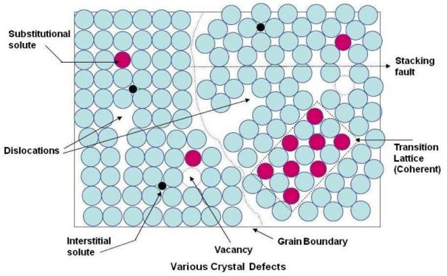
Crystalline materials
In crystalline materials, the lattices are not perfect, they have defects
Defects can be 0D, 1D, 2D, 3D
The interactions between defects seriously impact material properties and how they perform

Slide 38
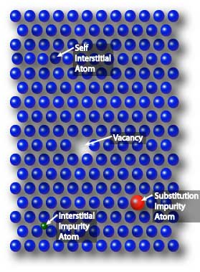
Point defects
Point defects (zero-dimensional defects) are lattice imperfections related to one or two lattice sites
There are several types of point defects
Vacancies
Self interstitial atoms (SIA)
Interstitial impurity atoms
Substitutional impurity atoms
Point defects control the mobility of atoms and, therefore influence all processes that depend on diffusion

Slide 39
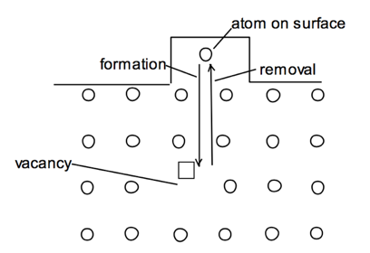
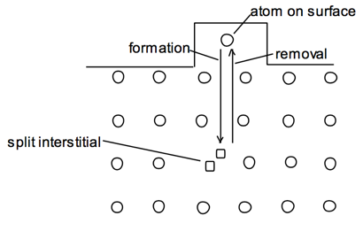
Point defects
Vacancies and interstitials form naturally in materials
Extra atoms can sit on a surface, creating a vacancy, or a surface can have a missing atom, creating a self interstitial atom (SIA)
We define the number of vacancies or interstitials in terms of a concentration
There exists an equilibrium concentration of point defects

Slide 40

Radiation damage
Ionizing radiation can introduce defects into the crystal lattice, called radiation damage
PKA collisions create a collision cascade, which results in the generation of defects (point and clusters)

